Slide 1
ISEM540 - PROJECT 2 SRPMM Healthcare Mexico
-By
Rajan Pawar
Medha Jha
Prithvi Anand Vadapally
Suraj Pratap Samirlal Poddar
Mayank Pulupa

Slide 2

Team Contribution
Team Member | Contribution %
Rajan Pawar | 20%
Prithvi Anand Vadapally | 20%
Suraj Pratap Samirlal Poddar | 20%
Medha Jha | 20%
Mayank Pulupa | 20%

Slide 3
Topic covered
Deliverable A – SOA Based Design
Deliverable A – Web Services (Cloud/Mobile)
Deliverable A – AWS, Azure and Google Cloud
Deliverable A – Portal Design
Deliverable A – SOA And Simple Design
Deliverable A – XML Code For Services
Deliverable B - Self-Assessment Report (Space)
Deliverable C - References And Annotations

Slide 4
Deliverable - A

Slide 5
Amazon Web Services
Amazon web services is cloud computing platform that includes a mixture of infrastructure as a service, platform as a service and software as a service.
Amazon web services provides services from dozens of data centers spread across availability zones in regions across the world.
Amazon elastic compute cloud provides virtual servers called EC2 instances. The EC2 offers instance types with varying capacities and sizes, tailored to workload types and applications such as memory intensive and computing jobs.
Along with EC2, will use Simple Storage Service (S3) for storage of data backup, collection and analytics. Even for the web traffic , for elastic load for traffic between servers, user's rational database etc.

Slide 6
Security Services by AWS
AWS provides services that help to protect data, account and workloads from unauthorized access.
AWS Identity services enables to securely manage the identities, resources and permissions.
Helps to filter out web requests based on IP addresses, HTTP headers, HTTP body or URI strings which can allow to block common attack patterns.
Automating security tasks on AWS is more secure by reducing human configuration errors and giving more time to team for other works.

Slide 7
Security Services by AWS
AWS security Hub is a high-priority security alert and compliance status across AWS accounts.
AWS security hub continuously monitors your environment using automated security checks based on AWS best practices.
We can take actions based on security findings by investigating them on Amazon Detective or Amazon CloudWatch.

Slide 8
Amazon Web Services For Mobile
Amazon Cognito is an AWS service that lets you create a unique and secure sign-up, sign-in, app authentication, and access control on web and mobile apps for users. This service is compatible with sites that require sign-ins such as Facebook, Amazon, Google, etc.
The Amazon Cognito User Pools is a feature that maintains a user directory that can accommodate hundreds of million users. As a secure identity provider, it supports identity and access management standards like OpenID Connect, OAuth 2.0 and SAML 2.0. It also supports authentication, security and compliance requirements.
With AWS Lambda, you can run code without managing or provisioning servers. So, you only pay for the actual computing time you use, and you’re not charged when your code is idle.
You can upload the codes for any type of apps or backend services, and AWS Lambda will take care of the rest, including scaling the code for maximum availability. Users don’t need to manage servers. You can set up the code to automatically trigger from other AWS services or use it from any mobile or web app

Slide 9

Microsoft Azure Services
Excels in Hybrid Cloud Space-Organizations can integrate onsite servers with Cloud instances.
Blobs, Queues and Tables- Like S3.
Provides security by enabling permissions on the whole account.[1]
Azure offers temporary storage through D drive, block storage through Page Blobs for VMs. Block Blobs and Files also serve as object storage
Microsoft offers Virtual Network (VNET) that offers users ability to create isolated networks as well as subnets, route tables, private IP address ranges and network gateways
Microsoft also has a strong track record for meeting new demand and offers Hadoop support with Azure HDInsight. Windows Server 2016 provides integration with Docker for both Windows containers and Hyper-V containers

Slide 10

WordPress
Pros: WordPress is a great low-cost option if you are looking to use it for a blog. WordPress has a ton of great plugins to customize the blog or site to your liking.
WordPress has many features and you can use it as a great tool to build a blog/website, but the fact is free it is awesome for a new entrepreneur, with low budget like me.[2]
Cons: Some of these plugins and themes are poorly coded and as such creates vulnerability concerns; allowing malicious inclusions and attacks on a standing website built on the framework.
WordPress is a website and blog creation and publishing platform with tools for aesthetic designing, visitor tracking, content storage and upload, good for beginners

Slide 11


Google Cloud
Google Cloud offers around 50 different services, whereas AWS offers more than 200 and is more feature-rich.
Google Cloud certainly has an advantage in terms of flexibility with far greater opportunities for customization of compute instances than AWS, which offers limited opportunities for customization. [3]
Each platform offers predefined instances to meet the needs of most businesses, but with the Google Cloud Platform, if compute needs do not match the predefined instances, it is possible to create custom VMs to avoid paying for capacity that is not required.
Cons: In 2016, 32% of participants responded saying that the number one cloud challenge was due to the lack of resources or expertise. In 2017, this number has dropped down to 25%.

Slide 12
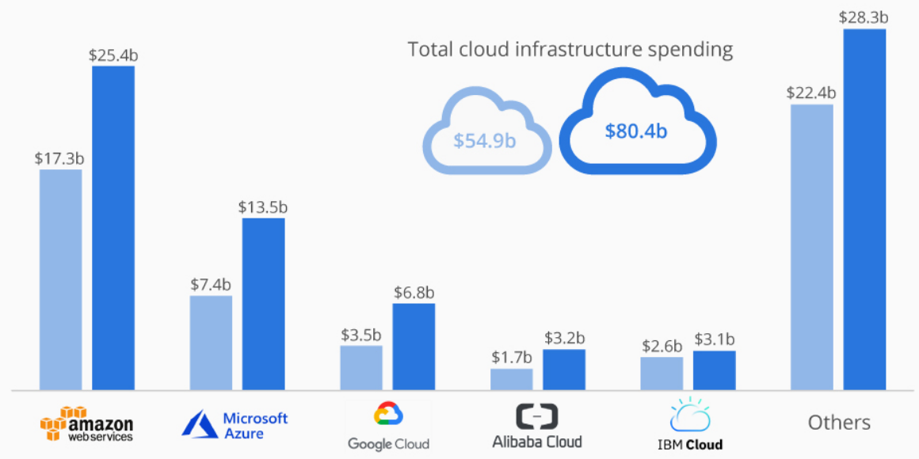
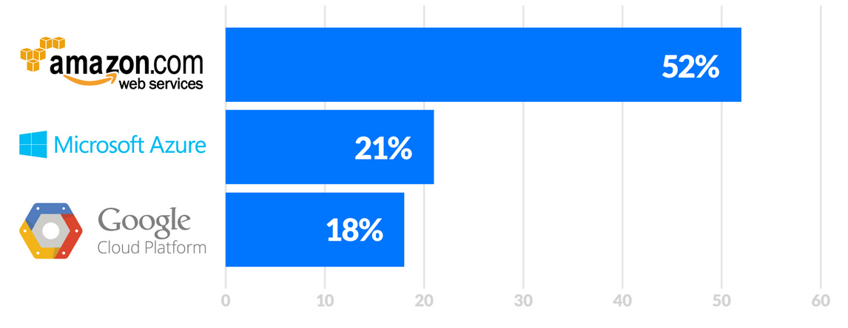
AWS VS Azure VS Google Cloud
Notes:
AWS is way ahead of Azure and google cloud. You can see that from the comparison.
Security
In the long-run, AWS has increased privacy and controls at lower rates. It assures to keep your data safe and meets compliance requirements. The security status of Azure is divided into five layers. It assures control and management of user access and identity, secures networks, manages threats and encrypts operation and communication processes.
Storage
Both Azure and AWS offer reliable and fast Block storage options. Azure consists of three types of storage services: Blob, File, Queue and Cool storages. The AWS cloud storage products are Elastic Block Storage (Amazon EBS), Elastic File System (Amazon EFS), Simple Storage Service (Amazon S3), Amazon Glacier, AWS Storage Gateway and Data Transfer Services.

Slide 13
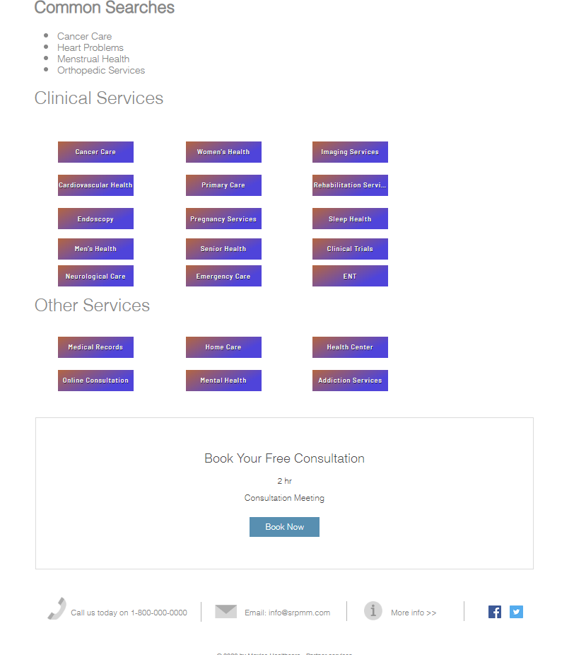
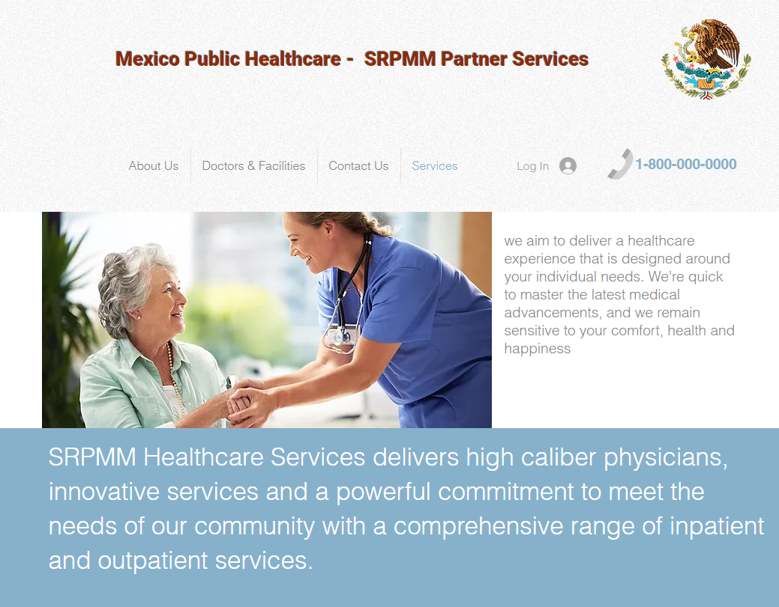
Portal Design
Notes:
This is our home page with all the services we provide. We have used AWS to host this website on cloud.

Slide 14


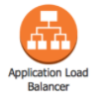


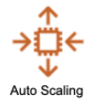







HIGH LEVEL Architecture
Availability Zone
Availability Zone
AWS CloudFront
Subnet
Subnet
Beacon web
Server
Beacon web
Server
AWS INCOGNITO
Real Time Daashboard
Transformation
Failure
Delivery Failure
Source records
Transformed Records
AWS Lambda
Function
Data Streams
Firehouse Delivery
Steram
Data Analytics
Elastisearch cluster
Notes:
Explanation:
Website is hosted on AWS
Beacon web servers in the picture above logs requests from users web browser and diverts the data to Firehouse Delivery Stream which archives the events in S3 bucket and forwards the data Analytics for processing
Lambda which is a serverless resource on AWS reads the data and sends it to Dynamo DB for the tables to be stored
The solution also consists of AWS cloudfront , Incognito user pool and a real time dashboard to display monitor and securely account activity stored in Dynamo DB

Slide 15
Web Service Data Exchange
Analyzer
User Input Text
API
Analytics Results
Admin
Send Request
Client Browser
Web
Server
Database
Controller
Return Response
View
Request
Send Request
Client Browser
analytics
Return
Return Response
Send Request
Client Browser
graphs
Return Response
Java client
REST backend
Echart API
Java client
Customer
service
Customer
service
Notes:
Web service architecture includes HTML5, javaScript, AJAX, CSS3 and bootstrap
The above diagram show the fron end web which is in direct contact with DB. These data are created in the back end to generate the necessary views on the DB

Slide 16


Feeder System
Notes and Care plan
Mediator
DB
Mediator
DB
Mediator
DB
Information Broker
Online Sync
of data
Home help Service
HHS
Mapping
Mediator
DB
Medical
Record
APP for HHS
General Practioner (GP)
Online access
of data
Nursing
Record and
Care plan
Web Application with views for DN and GP
District nurse (DN)
Notes:
Diagram representing the technical architecture of VHR Virtual Health record integrating information from different Electronic Health records which allows effectinve and efficient way of documenting care provider
This is an SOA where DB operations and services are seperated and implemented
The Patients record XML schema is populated in the interface for integration in the Information Broker as shown in the picture above

Slide 17
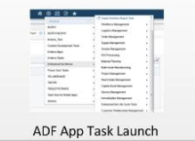
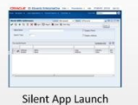
APP Server Data Exchange
Web Container
easy to scale
HTML Server
APP
APP
Login establishes ADF session
APP
APP
Web Container
REST-JSON
(App data)
ADF Server
Application Interface Server
HTML Server
Servlet Execute call
Form Sevice request
/jde/FormServiceRequest?<APP_ID>
JSON App data

Slide 18
Identity & Order Fullfillment Service in XML
<system value="phone"/>
<value value="12578544221"/>
<use value="mobile"/>
</telecom>
<telecom>
<system value="email"/>
<value value="louis.browndonotaccept@gmail.com"/>
<use value="home"/>
</telecom>
<gender value="male"/>
<birthDate value="1984-11-17"/>
<deceasedBoolean value="false"/>
<address>
<use value="home"/>
<line value="326 Market St"/>
<city value="Harrisburg"/>
<postalCode value="17101"/>
<country value="USA"/>
<!-- Codes -->
</address>
<maritalStatus>
<coding>
<system value="http://srpmm.healthcare.org/CodeSystem/MaritalStatus"/>
<?xml version="1.0" encoding="UTF-8"?>
<Patient xmlns="http://SRPMM.healthcare.org/fhir">
<id value="f001"/>
<use value="usual"/>
<system value="urn:oid:2.116.40.1.113883.2.4.6.3"/>
<!-- BSN identification system -->
<value value="728462983"/>
</identifier>
<identifier>
<use value="usual"/>
<system value="urn:oid:2.116.40.1.113883.2.4.6.3"/>
<!-- BSN identification system -->
</identifier>
<active value="true"/>
<name>
<use value="usual"/>
<family value="Brown"/>
<given value="Louis"/>
<suffix value="Mr"/>
</name>
<telecom>
Notes:
Sample of getting the resources in a patient ward
The following return Patient ID, FHIR Store, name of the parent and access token

Slide 19
<code value="M"/>
<display value="Married"/>
</coding>
<text value="Getrouwd"/>
</maritalStatus>
<multipleBirthBoolean value="true"/>
<contact>
<relationship>
<coding>
<system value="http://srpmm.healthcare.org/CodeSystem/v2-0131"/>
<code value="C"/>
</coding>
</relationship>
<name>
<use value="usual"/>
<family value="Banks"/>
<given value="Sarah"/>
</name>
<telecom>
<system value="phone"/>
<value value="1215474852"/>
<use value="mobile"/>
</telecom>
</contact>
<communication>
<language>
<coding>
<system value="urn:ietf:bcp:47"/>
<!-- language tag -->
<code value="nl"/>
<display value="Englist"/>
</coding>
<text value="United States of America"/>
</language>
<preferred value="true"/>
</communication>
<managingOrganization>
<reference value="Organization/f0001"/>
<display value="No Medical Centre"/>
</managingOrganization>
</Patient>

Slide 20
What are the advantages of a Standards-based Architecture versus vendor-based Architectures.
Standard based Architecture are
Easy Maintenance
Service Reusability
Availability and Scalability
Production Independent
Greater Productivity
Reduced risk

Slide 21
Deliverable – B & C

Slide 22
Self-Assessment Report
Team and Region/Sector Information, Region/Sector Selected (e.g., Island and healthcare):
Mexico, South America/ Healthcare Centre
Team members involved in Self-Assessment (team member name plus SPACE Planner User ID, no need for password):
Rajan Pawar/ rajan_pawar3@yahoo.com

Slide 23
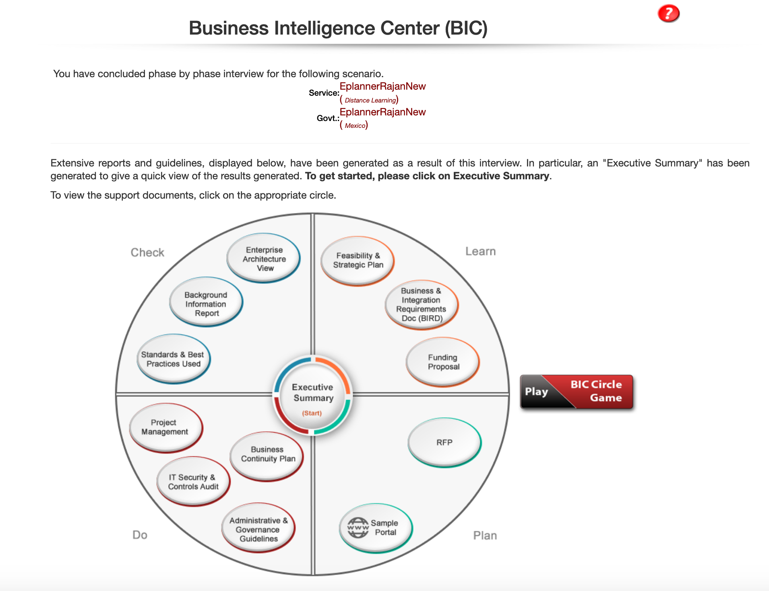
BIC Image

Slide 24
Bundle Type: Healthcare services
Member Name: Rajan Pawar
User ID: rajan_pawar3@yahoo.com
Scenario Name: RajanEplanner new
Was the Bundle Portal Generated Satisfactory (0-100%) : 80%
Were you Able to Collaborate with other Bundles using the Collaboration facility : Yes
What type of experiments were you able to run on your bundles : BIC diagram
The value of this Portal to Project12 (Low, Medium, High) : High
Please identify 3 strengths and 3 weaknesses of the SPACE Environment
Strengths are,
1. Very quick
2. Very detailed costs benefit report
3. BIC circle report is amazing
Weakness are,
1. Was not able to go backward while Initiative planning
2. Website is not very user friendly
3. Sometimes crashes
IMPROVING PROJECT1 RESULTS: List the Improvements in Your Report as a RESULT of this experiment (just a list)
Better planning in terms of Costs analysis, IT infrastructure and Project management
Did you find and evaluate at least one other tool available for EA that has similar capabilities?
Yes, iServer by Orbus software
What is the academic value of this exercise (Low, Medium, High). How can this value be improved
Medium – Personally, I felt that use-case based project would be more appropriate than this activity

Slide 25
Self-Assessment Report
Region/Sector Selected (e.g., Island and healthcare):
Mexico, South America/ Healthcare Centre
Team members involved in Self-Assessment (team member name plus SPACE Planner User ID, no need for password):
Medha Jha/ Medha.jha@my.harrisburgu.edu

Slide 26
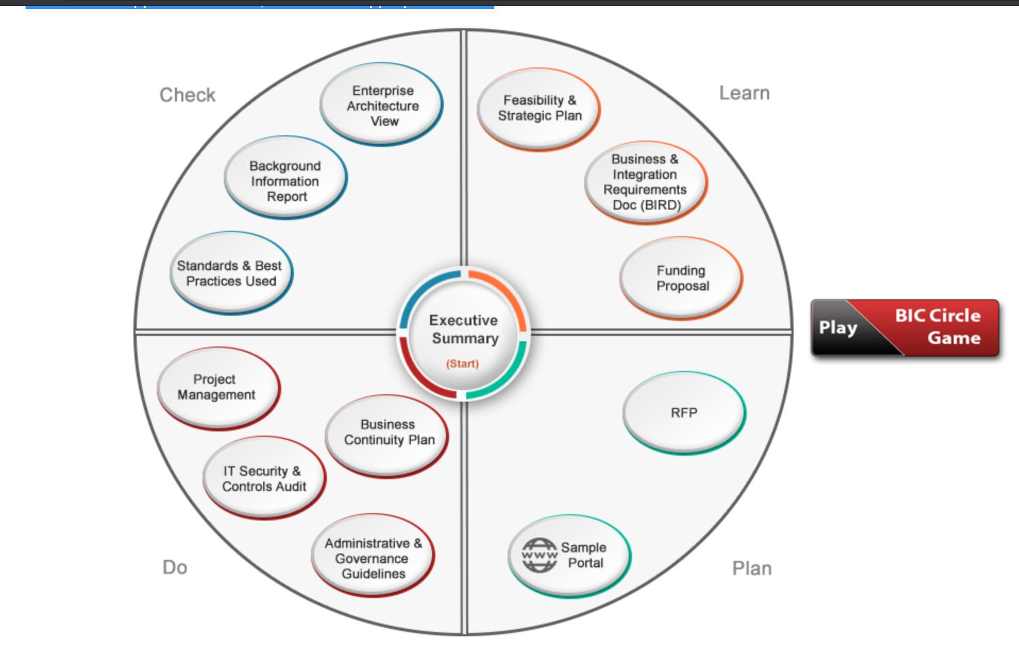
BIC Image

Slide 27
Bundle Type: Healthcare
Member Name: Medha Jha
User ID: Medha.jha@my.harrisburgu.edu
Scenario Name: Medha Eplanner
Was the Bundle Portal Generated Satisfactory (0-100%) : 80%
Were you Able to Collaborate with other Bundles using the Collaboration facility : Yes
What type of experiments were you able to run on your bundles : BIC
The value of this Portal to Project12 (Low, Medium, High) : High
Please identify 3 strengths and 3 weaknesses of the SPACE Environment
Strength - Provides Technology suggestion, Cost benefit analysis, Policy suggestions
Weakness – Not very user-friendly UI, Content is not accessible sometimes, Some UI bugs
IMPROVING PROJECT1 RESULTS: List the Improvements in Your Report as a RESULT of this experiment (just a list)
Can improve on adding training for resources and staff guidelines. Trainings can be included as a prerequisite mandatory course or a parameter.
Did you find and evaluate at least one other tool available for EA that has similar capabilities?
Yes, LeanIX by LeanIX
What is the academic value of this exercise (Low, Medium, High). How can this value be improved
Medium – The exercise is very valuable, but there is lot of information and is sometimes difficult to grasps in one go. This could have been broken into smaller parts rather than just one

Slide 28
Self-Assessment Report
Region/Sector Selected (e.g., Island and healthcare):
Mexico, South America/Healthcare Centre
Team members involved in Self-Assessment (team member name plus SPACE Planner User ID, no need for password):
Prithvi Vadapally/ pvadapally@my.harrisburgu.edu

Slide 29
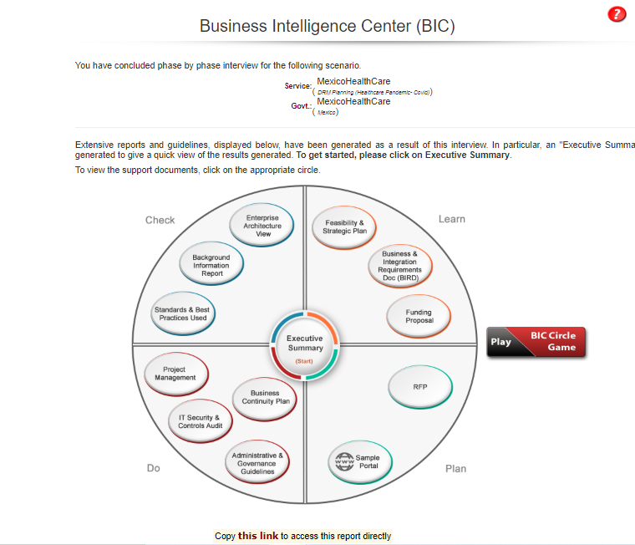
BIC Image

Slide 30
Bundle Type: Informational and Transactional
Member Name: Prithvi Vadapally
User ID: pvadapally@my.harrisburgu.edu
Scenario Name: Mexico Health Care
Was the Bundle Portal Generated Satisfactory (0-100%) : 85%
Were you Able to Collaborate with other Bundles using the Collaboration facility : Yes
What type of experiments were you able to run on your bundles : BIC Comprehensive Analysis
The value of this Portal to Project12 (Low, Medium, High) : High
Please identify 3 strengths and 3 weaknesses of the SPACE Environment
Strength are,
1. Decision Table generated for to-do tasks
2. BIC report with all at one place report
3. Cost benefit analysis suggestions
Weakness – Not very popular in market, GUI not very user friendly, too many variables are sometimes confusing
IMPROVING PROJECT1 RESULTS: List the Improvements in Your Report as a RESULT of this experiment (just a list)
Better project planning for a big project, more analysis on costs benefits and Design on IT infrastructure
Did you find and evaluate at least one other tool available for EA that has similar capabilities?
Yes, Ardoq by Ardoq
What is the academic value of this exercise (Low, Medium, High). How can this value be improved
High – It is a very good exercise, very detailed and hand-on practical exercise, according to me

Slide 31
Self-Assessment Report
Team and Region/Sector Information:
Region/Sector Selected (e.g., Island and healthcare): Mexico, South America/Healthcare Centre
Team members involved in Self-Assessment (team member name plus SPACE Planner User ID, no need for password): Suraj Pratap/275644

Slide 32
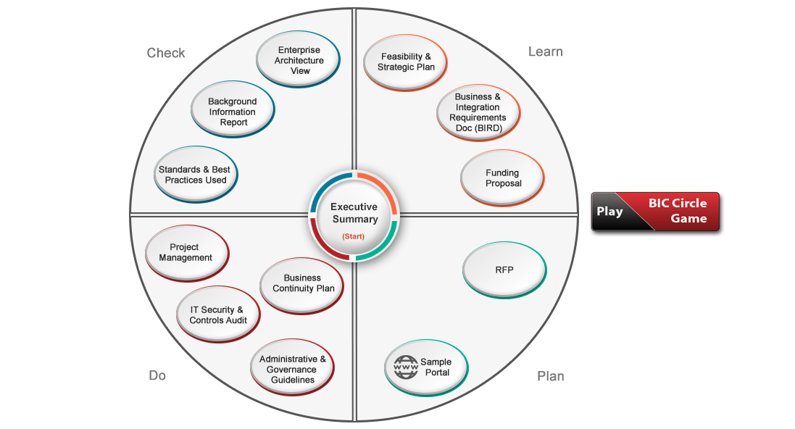
BIC Image
http://space4ict.com/fetcher.aspx?val=r8fjdyHWy%2fnCGSN%2f%2fTDUBulmQIoEQD8uQjimgcUCMm1b9vK6e43sgpEqa0K8wJ%2bmn5MpRaWevv5E8rkQ9ru5DT%2bKcpiDGbjptSMjzsw7OK9WJ2%2bNEoUa8PHHa%2fP1vApMzxHX2mTsNEyLTKaG9%2f5MxXFHhcPar65WMELJU4ZpZWzVh29nYL%2bZgQ%3d%3d

Slide 33
Bundle Type: Healthcare Services
Member Name: Suraj Pratap Samirlal Poddar
User ID: 275644
Scenario Name: SurajEplanner
Was the Bundle Portal Generated Satisfactory (0-100%) : 90%
Were you Able to Collaborate with other Bundles using the Collaboration facility : Yes
What type of experiments were you able to run on your bundles : BIC Diagram
The value of this Portal to Project12 (Low, Medium, High) : High
Please identify 3 strengths and 3 weaknesses of the SPACE Environment
Strength – Detailed steps to generate the report, Flexible options for SWOT and cost benefit analysis, Very appropriate suggestions for policies.
Weakness – Look and feels can improved, Could cut down on few parameters, Prepopulated values can be used in place of optional fields
IMPROVING PROJECT1 RESULTS: List the Improvements in Your Report as a RESULT of this experiment (just a list)
Better planning in terms of Costs analysis, IT infrastructure and Project management
Did you find and evaluate at least one other tool available for EA that has similar capabilities?
Yes, iServer by Orbus software
What is the academic value of this exercise (Low, Medium, High). How can this value be improved
Medium – Personally, I felt that use-case based project would be more appropriate than this activity

Slide 34
Self-Assessment Report
Team and Region/Sector Information:
Region/Sector Selected (e.g., Island and healthcare): Mexico, South America/Healthcare Centre
Team members involved in Self-Assessment (team member name plus SPACE Planner User ID, no need for password): Mayank Pulapa/ Mayankbhargav52@gmail.com

Slide 35
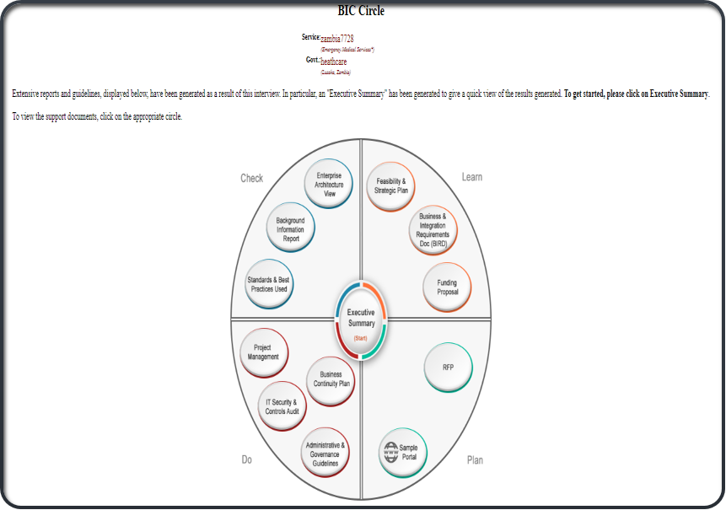
BIC Image
http://space4ict.com/fetcher.aspx?val=r8fjdyHWy%2fnCGSN%2f%2fTDUBpqQliJ1jPUbQnvKFL4zCWk%2bmotDYHePmQVPWFuHx1K2eHDMXXmCgsGhhyAuB0J9w6Ncn5RqrUOgFlIbJYFqOrsfFpKor1N3STFR1h2EtbX%2fmZWe1gTQPtpYoRcoEv8EWezJNKaJ8nYHvndmCY%2f9ZCE%3d

Slide 36
Bundle Type: Healthcare
Member Name: Mayank
User ID: Mayankbhargav52@gmail.com
Scenario Name: zambia7728
Was the Bundle Portal Generated Satisfactory (0-100%) : 85%
Were you Able to Collaborate with other Bundles using the Collaboration facility : Yes
What type of experiments were you able to run on your bundles : BIC analysis
The value of this Portal to Project12 (Low, Medium, High) : High
Please identify 3 strengths and 3 weaknesses of the SPACE Environment
Strengths- Instant access to lot of sectors or countries data, Detailed report on every stage of the project, efficient output, availability on web
Weaknesses: Too many parameters asked which was difficult at times to understand and fill out and also Dependency on the available services for a given sector
IMPROVING PROJECT1 RESULTS: List the Improvements in Your Report as a RESULT of this experiment (just a list)
Governance Controls, Security Controls, Audit, Best Practices, background information and Automation strategy.
Did you find and evaluate at least one other tool available for EA that has similar capabilities?
Yes, HOPEX by Mega International
What is the academic value of this exercise (Low, Medium, High). How can this value be improved
Medium – It was very informative exercise but understanding of detailed inputs on the architecture report could have been a plus

Slide 37
References
https://kinsta.com/blog/google-cloud-vs-aws/
https://www.cloudhealthtech.com/blog/google-cloud-vs-aws
http://space4ict.com/pages/speplanner.aspx

